Slide 1










Key
 | Birds
 | Plants
 | Mammals
 | Fish
 | Invertebrates
 | Benthos
 | Plankton
Birds
Plants
Fish
Mammals
Invertebrates
Benthos
Plankton
 | Birds |  | Invertebrates
 | Plants |  | Benthos
 | Mammals |  | Plankton
 | Fish
Terrestrial
Marine
Freshwater
Terrestrial
Marine
Freshwater
Notes:
Bird – created by parkjisun
Tree – created by Delwar Hossain,
Deer – created by Francisca Arévalo
Fish – created by Iconic
Butterfly – created by Jacqueline Fernandes
Shell – created by B Barrett Noun project
Bacteria – created by Boris Belov
Mountains by alice noir, ocean by alex muravev, lake by By Anton Gajdosik

Slide 2
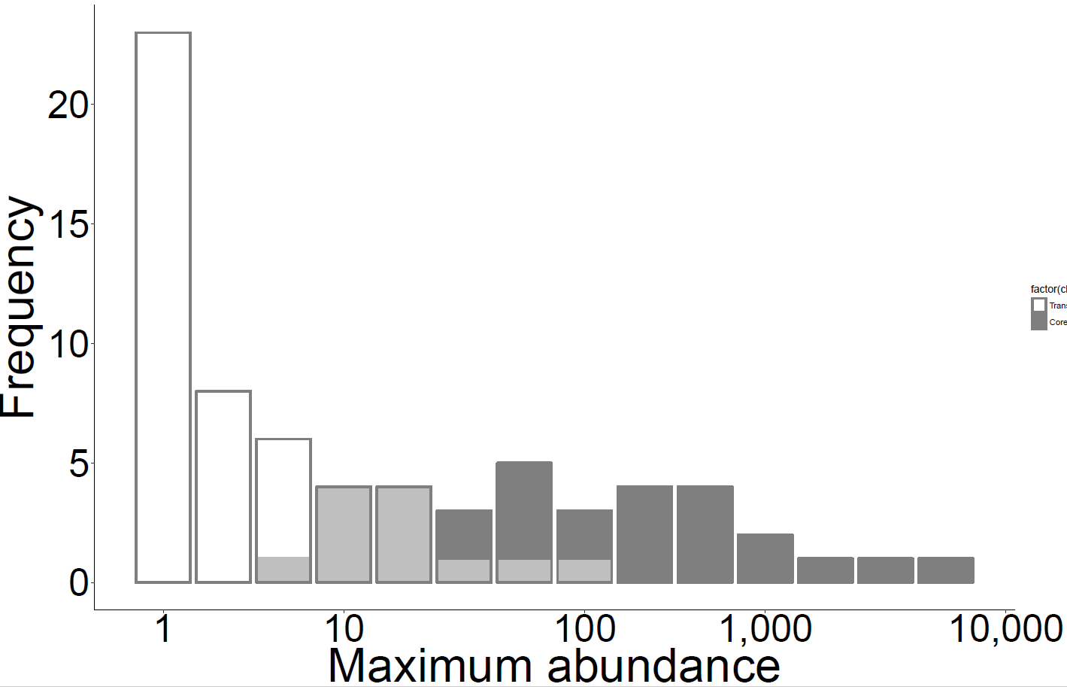
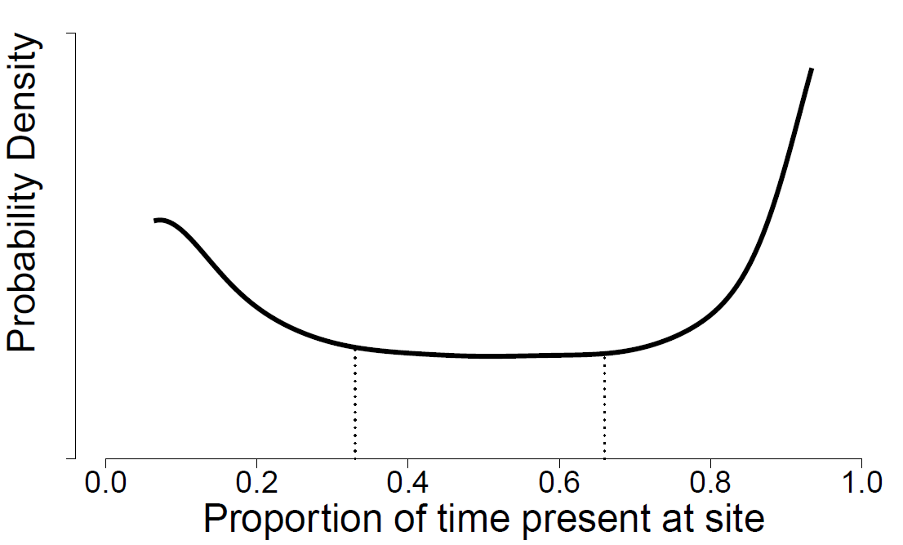
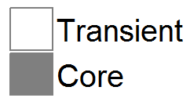
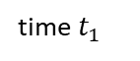
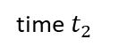
A
B
Transient
Core
C
D
All species
log(Species)
Excluding transients
log(area)
E
All species:
= 50%
Excluding
transients:
0
= 0%
time $t_{1}$
time $t_{2}$
Turnover
Notes:
Figure 1

Slide 3
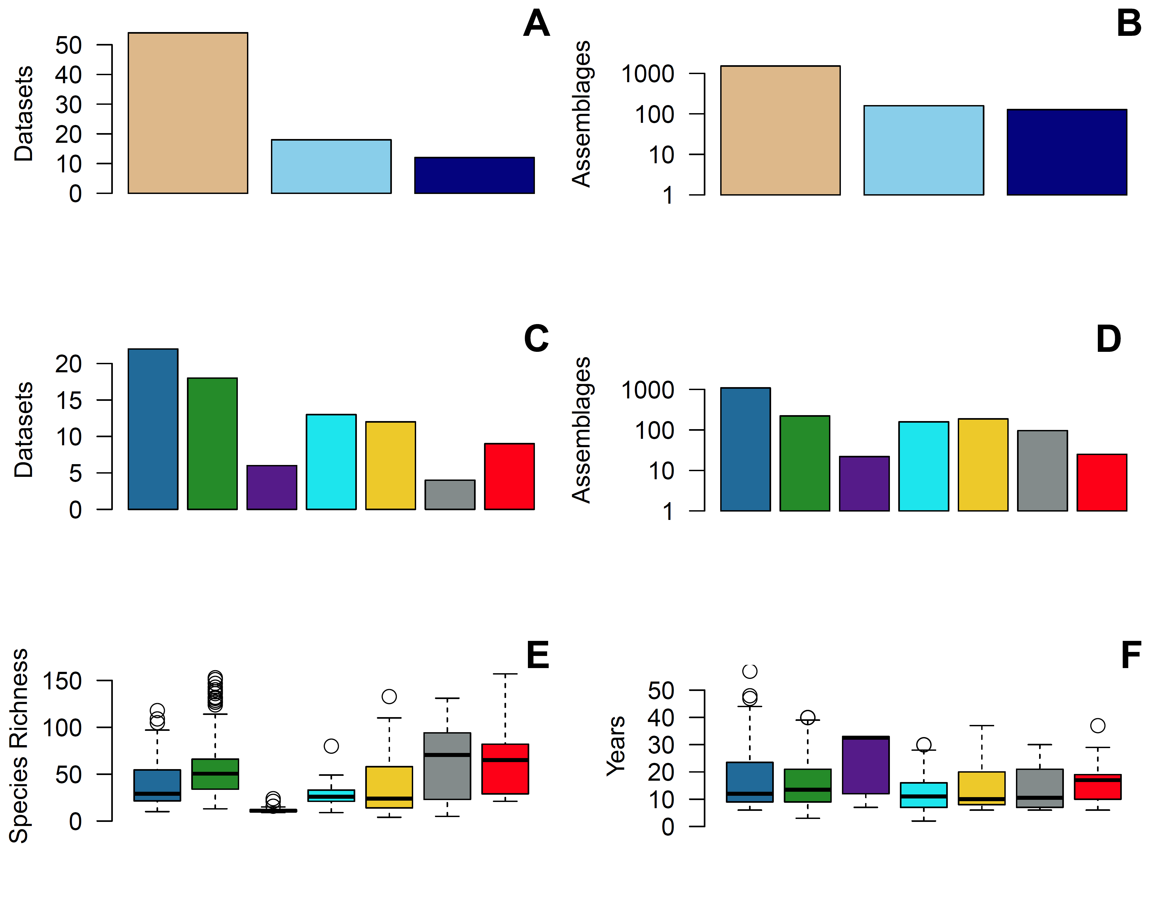
Birds
Invertebrates
Terrestrial
Benthos
Marine
Plants
Freshwater
Fish
Plankton
Mammals
Notes:
Fig 1a-1f

Slide 4
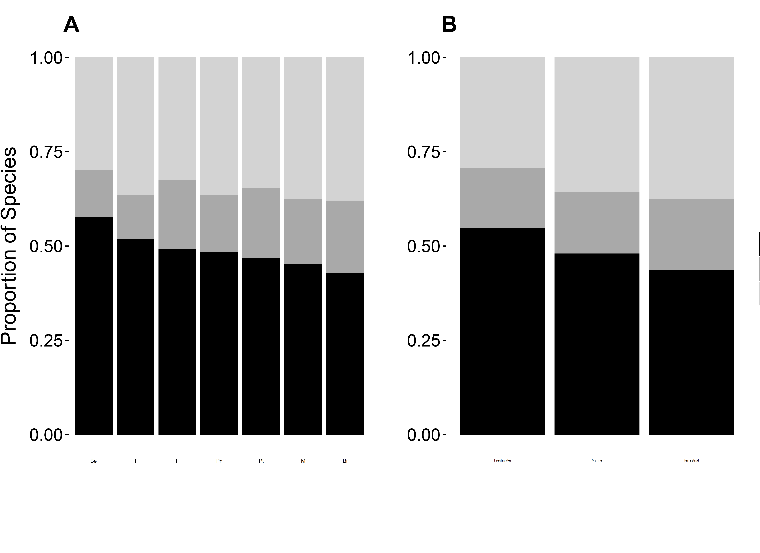
Notes:
Fig 3a_3b

Slide 5
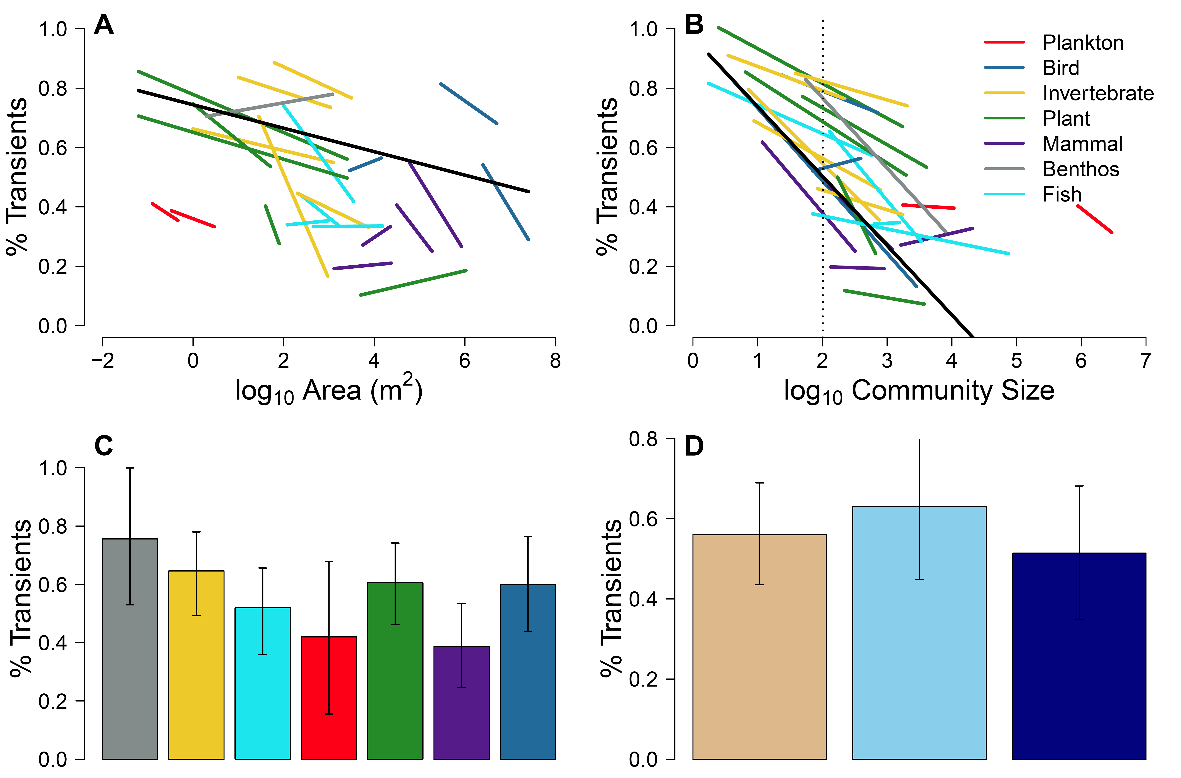
Simple R² = 0.44
Marginal R² = 0.12
Simple R² = 0.29
Marginal R² = 0.01
Notes:
Figure 4A-4D

Slide 6

0
lognormal
0.5
1
logseries

Slide 7
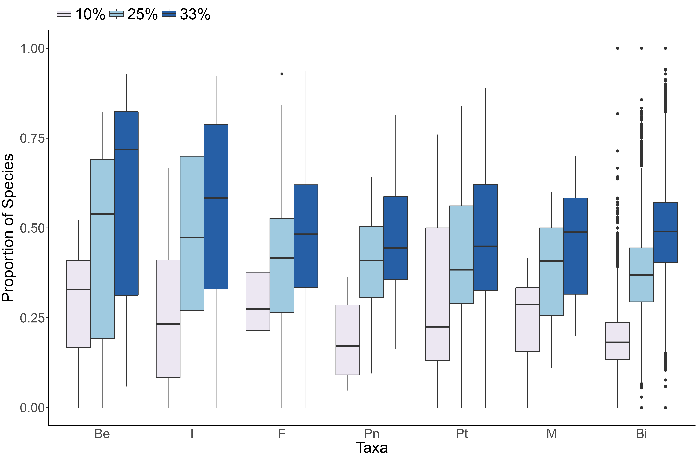

Slide 8
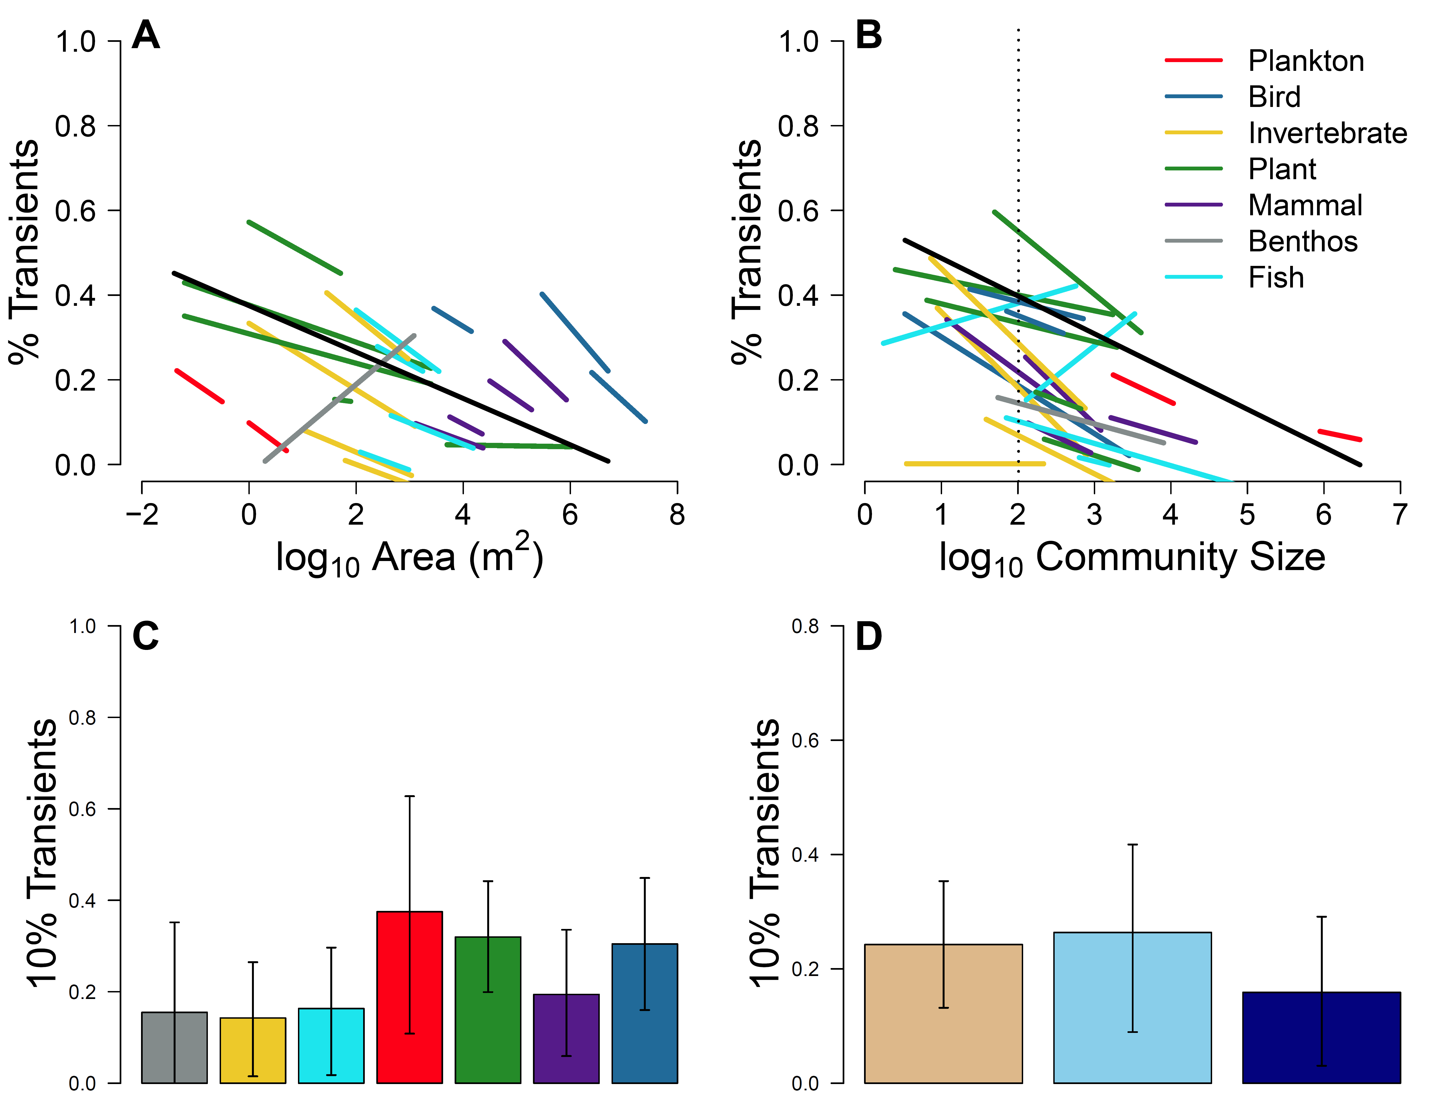
Simple R² = 0.19
Marginal R² = 0.05
Simple R² = 0.21
Marginal R² = 0.06
Notes:
Figure 4 - S10

Slide 9
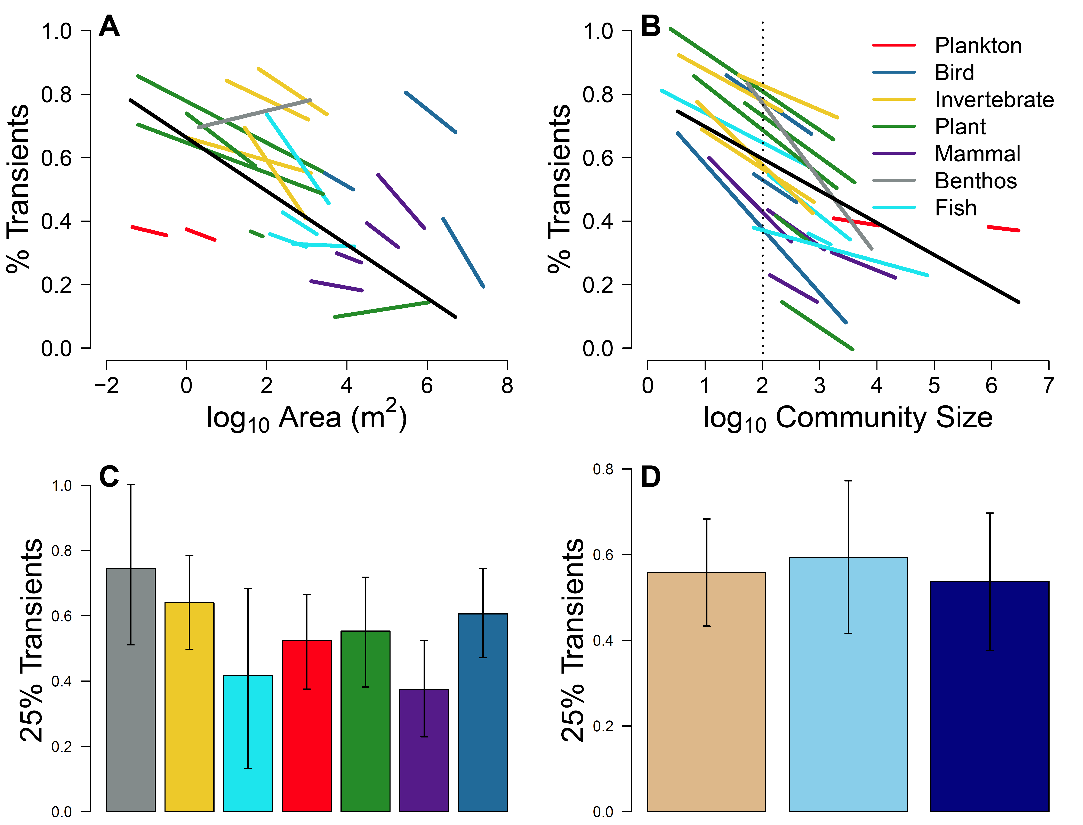
Simple R² = 0.33
Marginal R² = 0.11
Simple R² = 0.48
Marginal R² = 0.02
Notes:
Figure 4 - S25

Slide 10
0
0.5
1
lognormal
logseries
Notes:
Fig 5 – S10

Slide 11
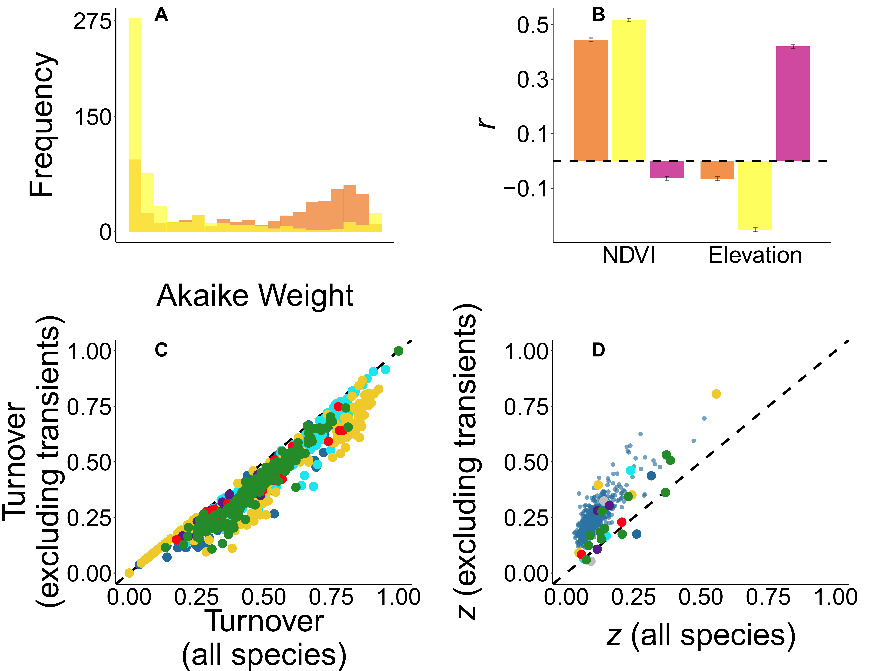
0
0.5
1
lognormal
logseries
Notes:
Figure 5 – S25

Slide 12
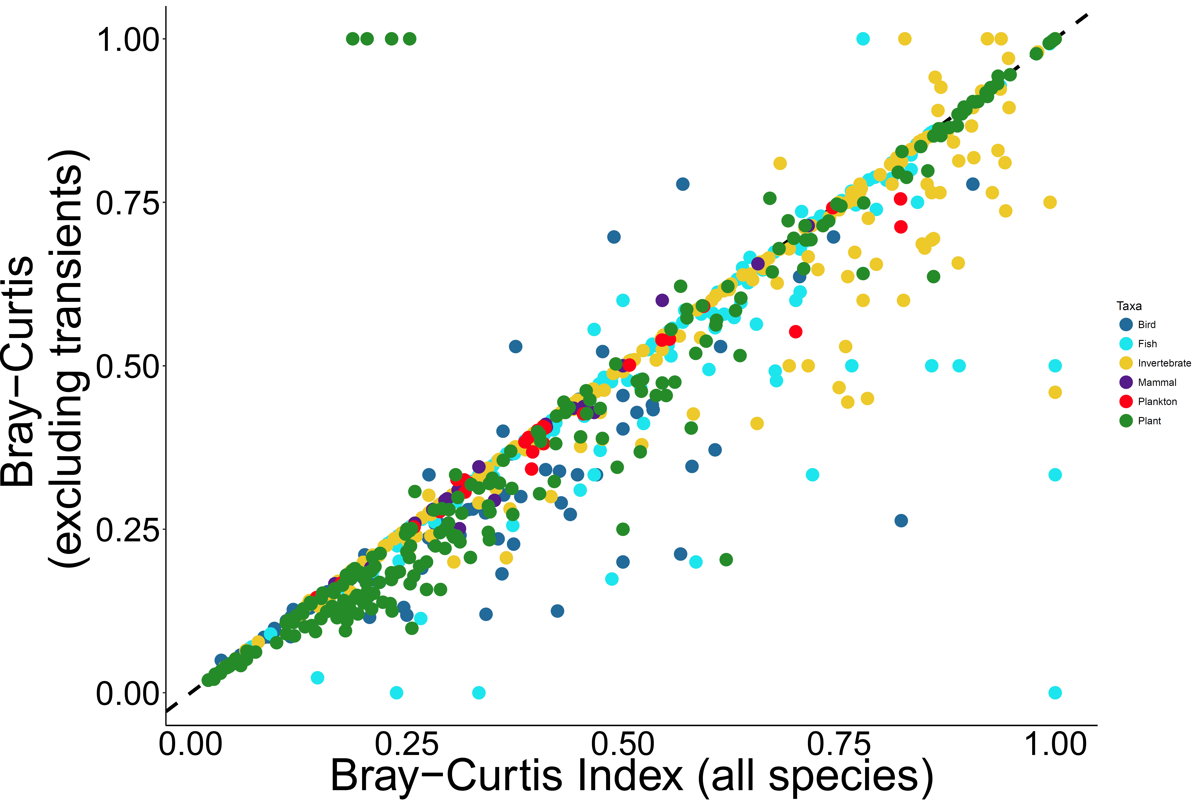

Slide 13
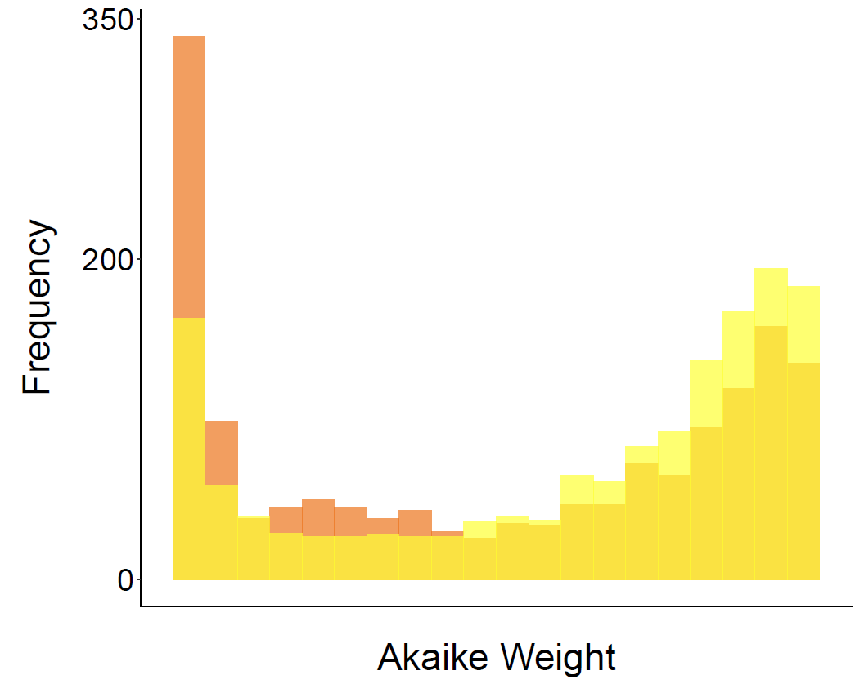
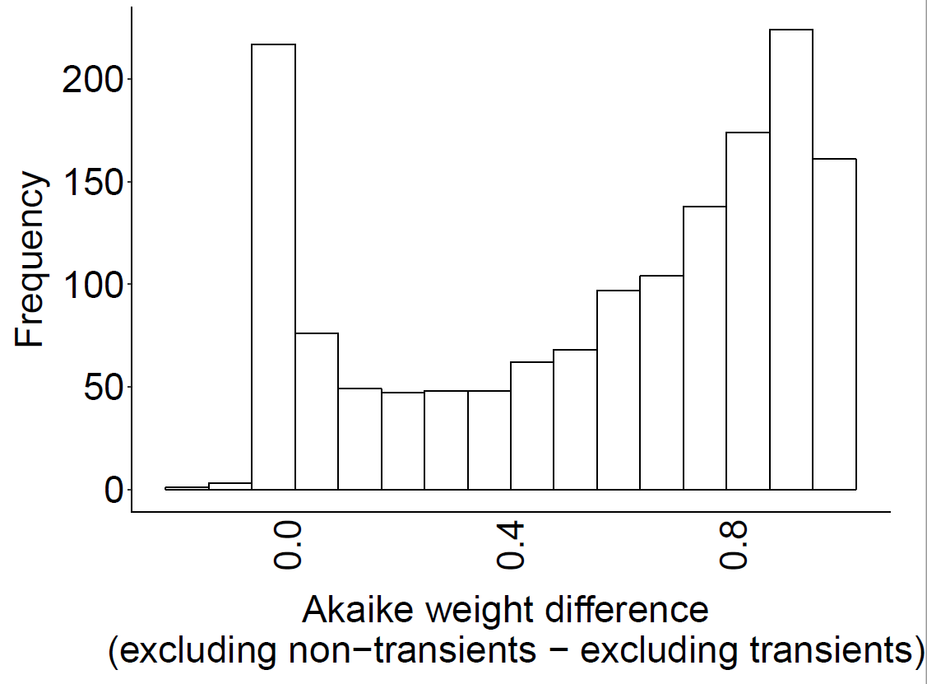
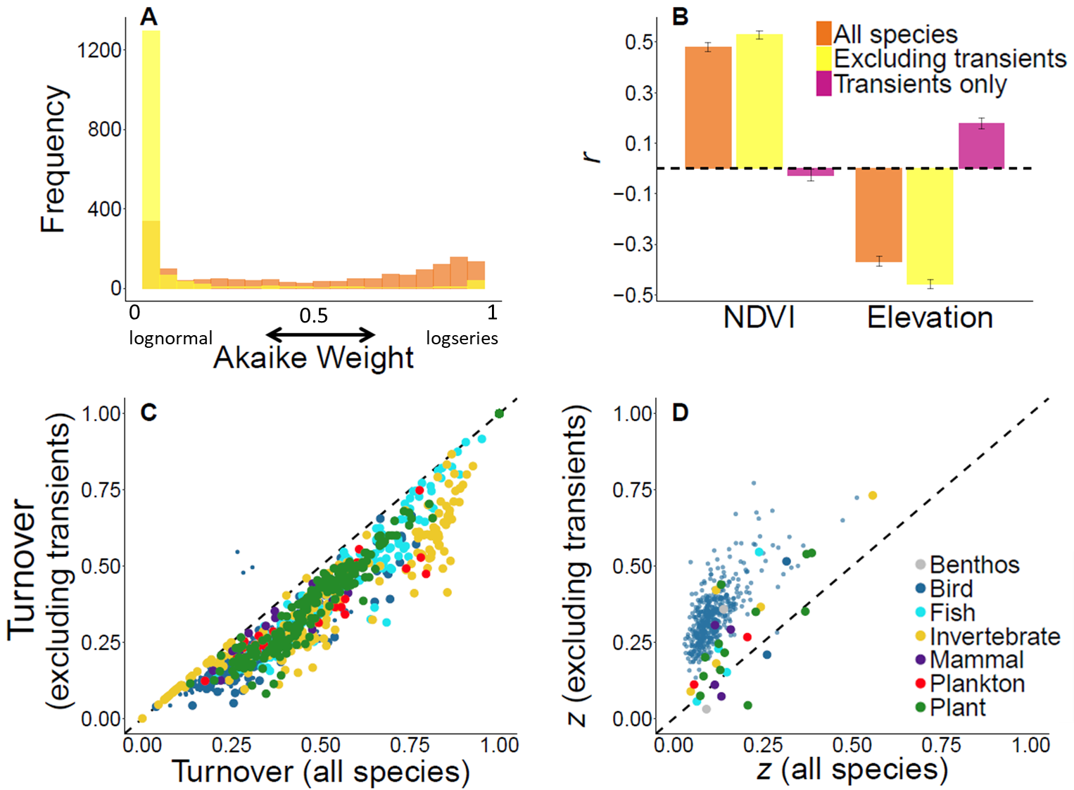
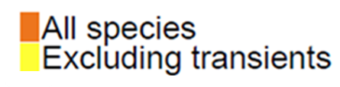
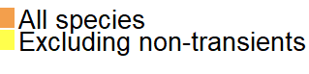
1a null
A
B
C
Frequency
Frequency
0
lognormal
1
logseries
0.5
Akaike Weight

Slide 14
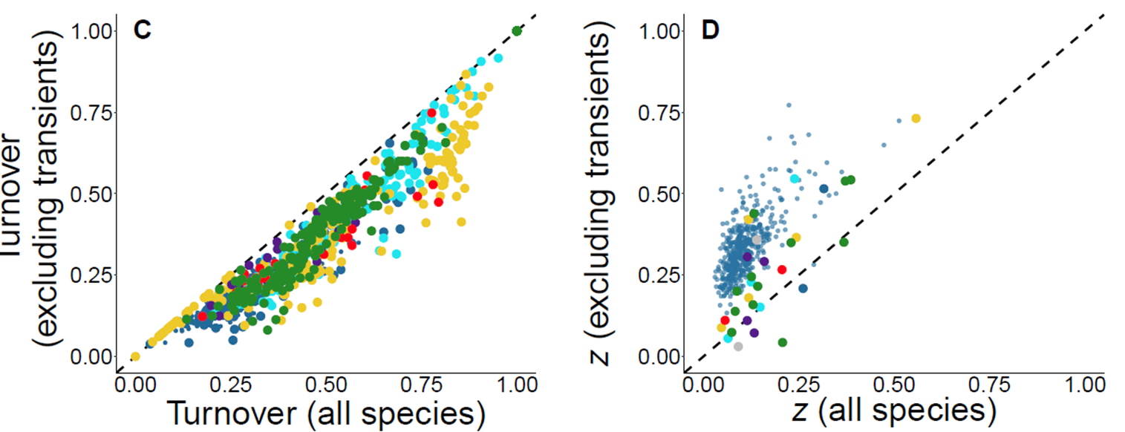
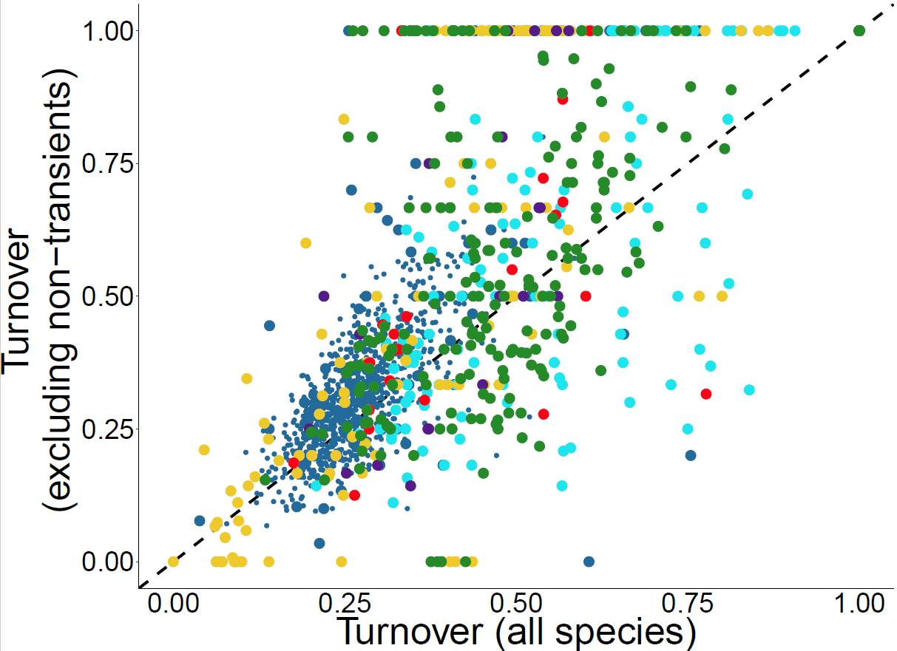
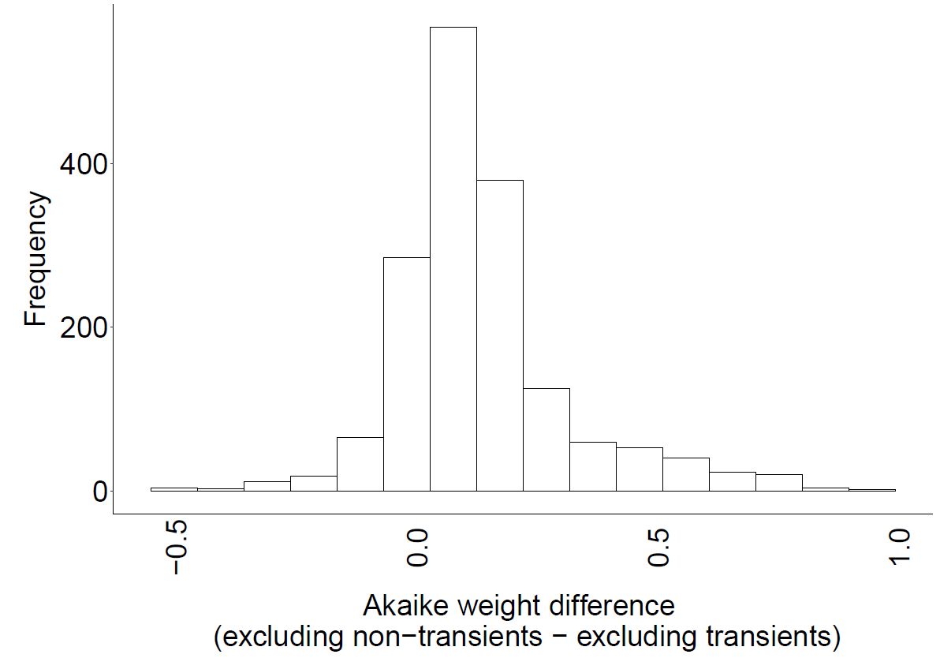
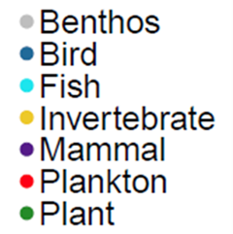
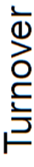
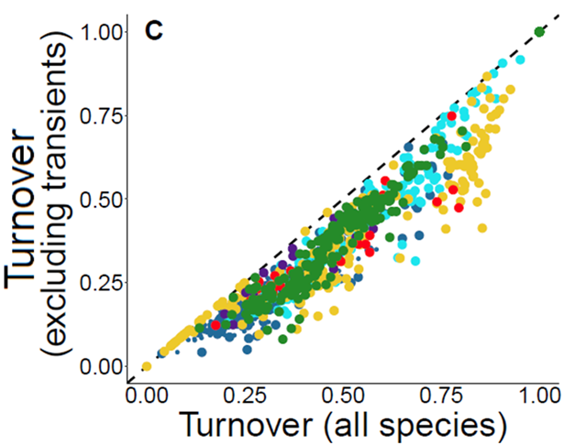
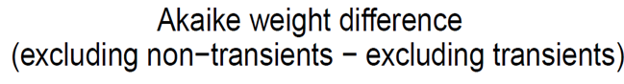
Null turnover
A
B
C
Frequency

Slide 15
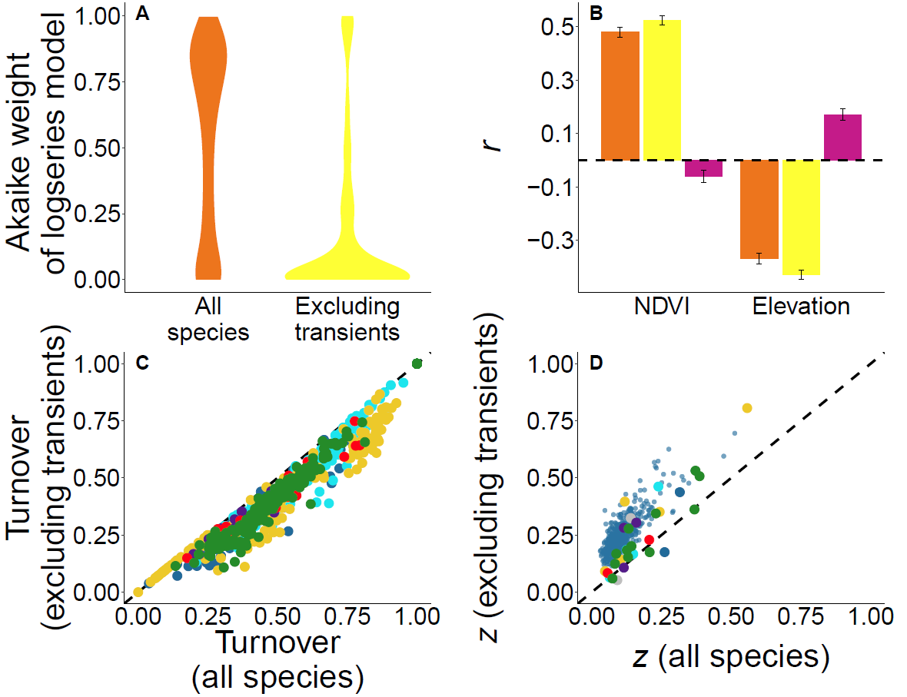
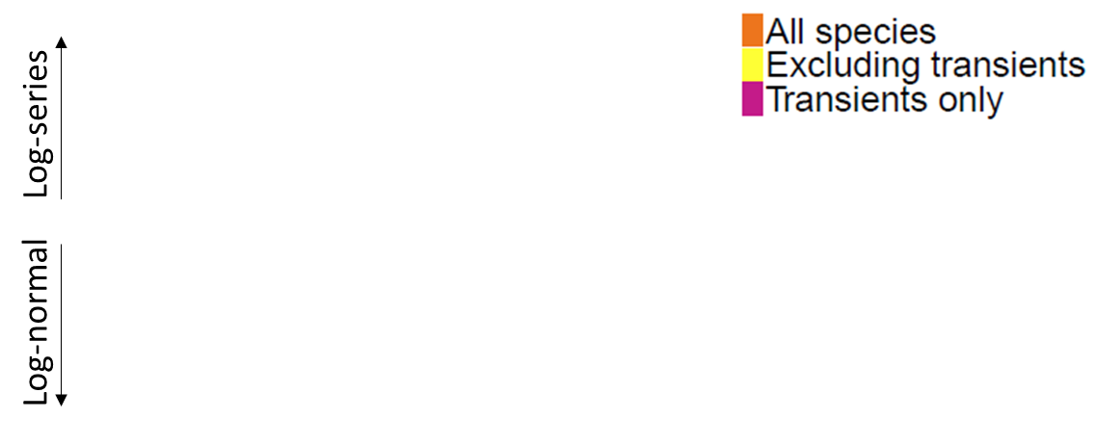

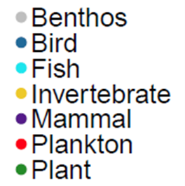

Slide 16
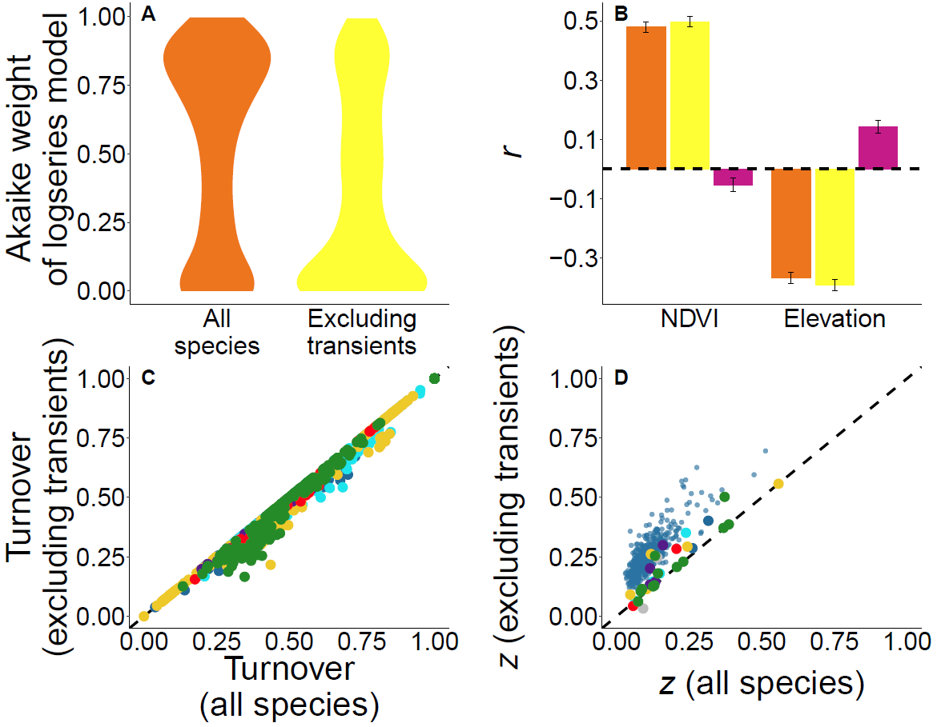
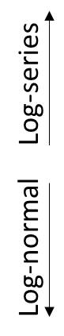
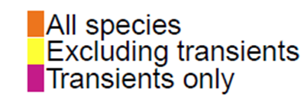

Slide 17







Species temporal occupancy strongly determined by environment
Species temporal occupancy strongly determined by competition

